Slide 1
INTERNET OF THINGS IBM – NAAN MUdHALVAN COURSE
PHASE 2 : INNOVATION
TEAM RADIANCE
NARMADA . S
NITHYASREE . M
PRIYADHARSHINI . H

Slide 2
PROBLEM STATEMENT
The project involves integrating IoT sensors into public transportation vehicles to monitor ridership, track locations, and predict arrival times. The goal is to provide real-time transit information to the public through a public platform, enhancing the efficiency and quality of public transportation services. This project includes defining objectives, designing the IoT sensor system, developing the real-time transit information platform, and integrating them using IoT technology and Python.

Slide 3
DESIGN:
DIGITAL BUS STATION SIGNAGE WITH RFID FOR ENHANCED PASSENGER EXPERIENCE
In the quest to modernize and streamline public transportation communication, our initiative adopts RFID technology, a game-changer in real-time data relay. By outfitting buses with RFID tags, we can swiftly capture and convey vital transit particulars. This information is then vividly and dynamically represented on digital displays at bus stations. As passengers receive timely updates, confusion and waiting times diminish. Consequently, this holistic approach not only magnifies the commuter experience but also fortifies the operational integrity and responsiveness of bus terminal systems.

Slide 4







STEPS INVOLVED

Slide 5
HARDWARE SETUP

Slide 6
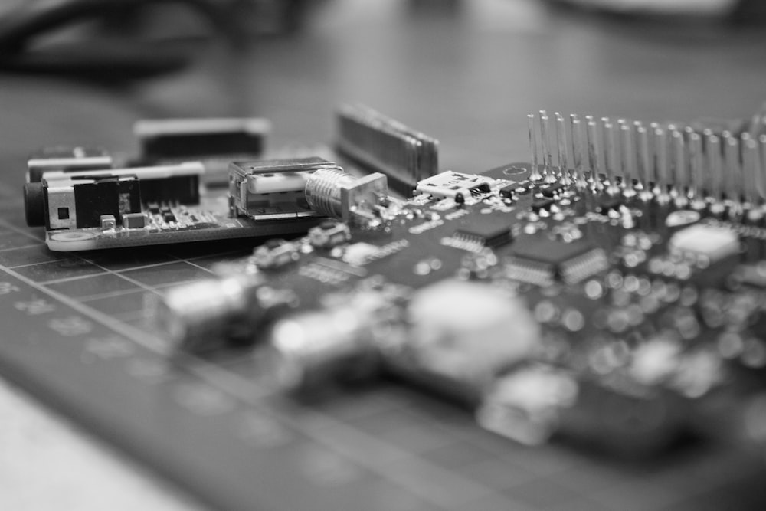
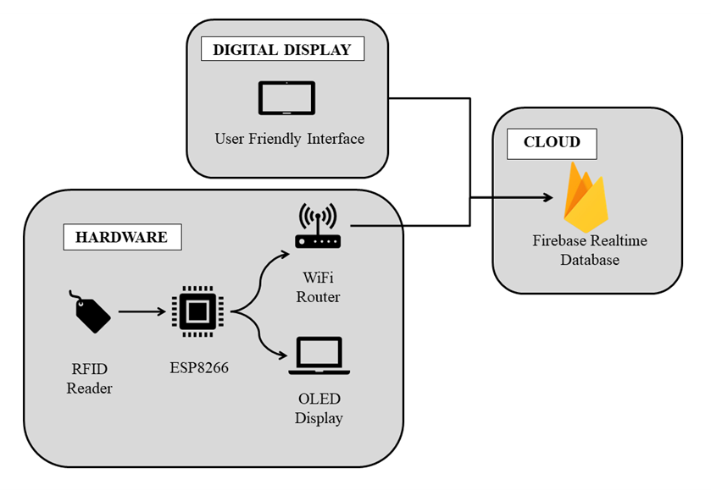
HARDWARE SETUP

Slide 7
Initially, we are connecting the hardware components together (i.e., ESP8266, RFID readers and the tags).
ESP8266 NodeMCU Connections:
ESP8266 NodeMCU → → → Power Supply
RFID MRFC522 Entry Gate Connections:
RFID MRFC522 (Entry) → → → ESP8266 NodeMCU
RFID MRFC522 Exit Gate Connections:
RFID MRFC522 (Exit) → → → ESP8266 NodeMCU
OLED Display Connections:
OLED SSD1306 → → → ESP8266 NodeMCU

Slide 8
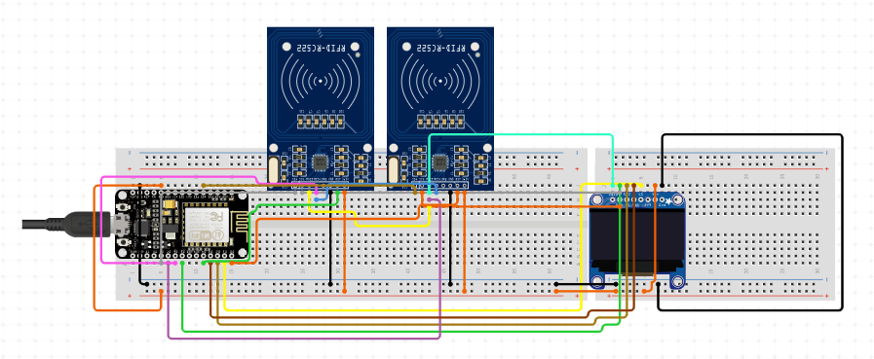

Slide 9
INSTALLATION OF
Libraries

Slide 10

INSTALLATION OF LIBRARIES
MFRC522 for RFID
Adafruit GFX for graphics
Adafruit GFX for graphics
Firebase ESP8266 for Firebase integration
Purpose:
Reads data from RFID cards and RFID readers.
Usage:
Allows your device to communicate with RFID hardware and read RFID card information.
Purpose:
Provides graphics functions for displays.
Usage:
Simplifies drawing shapes, text, and graphics on screens, especially OLED and TFT displays
Purpose:
Controls OLED displays using the SSD1306 driver.
Usage:
Enables you to interact with and display information on OLED screens, commonly used in IoT projects.
Purpose:
Connects ESP8266-based devices to Firebase.
Usage:
Facilitates communication between your ESP8266 projects & Firebase's real-time cloud database for data storage and retrieval.

Slide 11
FIREBASE SETUP

Slide 12


What is Firebase? What is Firebase Realtime Database?
Firebase: A Google-developed platform for app development.
Firebase Realtime Database: A core Firebase service, it's a NoSQL cloud database.
Data Structure: Organizes data in a JSON-like tree structure.
Real-time Data: Supports instant data updates across multiple clients.
Offline Capability: Provides functionality for offline data access.
Authentication Integration: Seamlessly works with Firebase Authentication.
Managed Scalability: Scales automatically as your app grows.
Cross-platform: Compatible with various programming languages and platforms.

Slide 13
SETUP PROCESS
Create a Firebase account if you don't have one.
Set up a Firebase Realtime Database, defining its structure and rules.
Obtain your Firebase project credentials, including:
FIREBASE_HOST: The URL of your Firebase project.
FIREBASE_AUTH: The authentication token for secure communication.
Firebase provides the cloud backbone for your digital bus station signage project, enabling real-time data storage and synchronization.

Slide 14
Developing firmware

Slide 15

FIRMWARE DEVELOPMENT
Develop the program that runs on your ESP8266 NodeMCU.
Include RFID reader initialization, OLED display control, and Wi-Fi setup.
Create logic for detecting bus entry and exit through RFID.
Display relevant bus information on the OLED screen.
Integrate with Firebase to store and retrieve data.
Handle entry and exit events and update Firebase accordingly.
Implement error handling for a robust system.

Slide 16
CREATING WEB INTERFACE

Slide 17

FIRMWARE DEVELOPMENT
Craft an engaging web page with HTML, CSS, and JavaScript.
Harness the Firebase JavaScript SDK to seamlessly connect to your Firebase Realtime Database.
Effortlessly retrieve and display real-time bus information, including entry time and platform.
Ensure the web page enchants users with automatic updates as data changes in the database.
Elevate the user experience with stylish design and intuitive features.
Celebrate the successful testing of your dynamic web interface, compatible across various browsers.

Slide 18
UPLOADING
&
TESTING

Slide 19

UPLOADING AND TESTING
Upload the prepared Arduino firmware to your ESP8266 NodeMCU.
Monitor the serial output for debugging and error detection.
Initiate RFID card tests to verify entry and exit functionality.
Confirm that the OLED display correctly shows bus information.
Ensure the integration with Firebase works as expected.
Address any issues or bugs identified during testing for a reliable system.

Slide 20
THANK YOU

